Slide 1

Overview of Descriptive Statistics
Prepared By:
Santosh pyakurel
Jivan Pokhrel

Slide 2
Measures of Central Tendency
A measure of central tendency is a descriptive statistic that describes the average, or typical value of a set of scores
There are three common measures of central tendency:
  the mode
  the median
  the mean

Slide 3
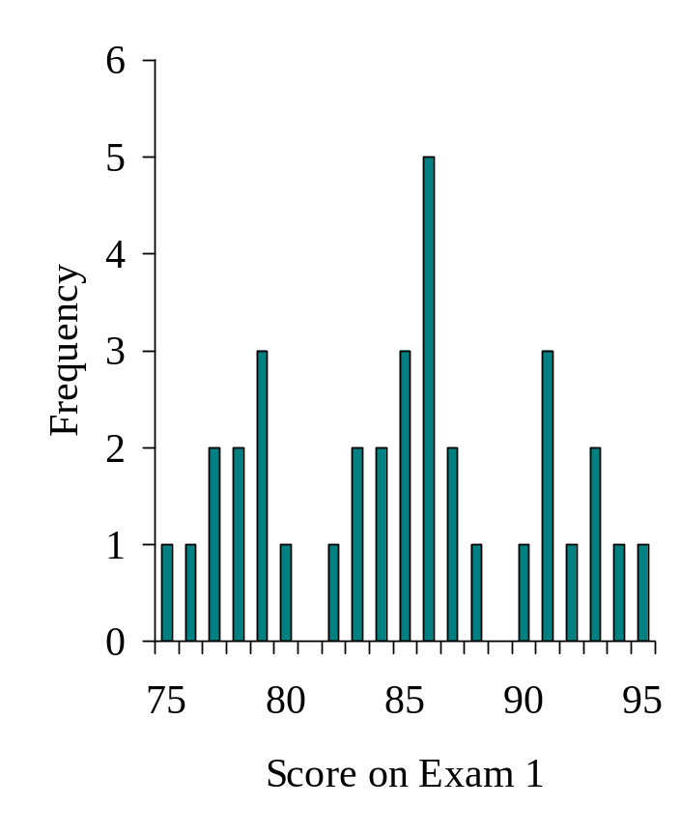
The Mode
The mode is the score that occurs most frequently in a set of data

Slide 4
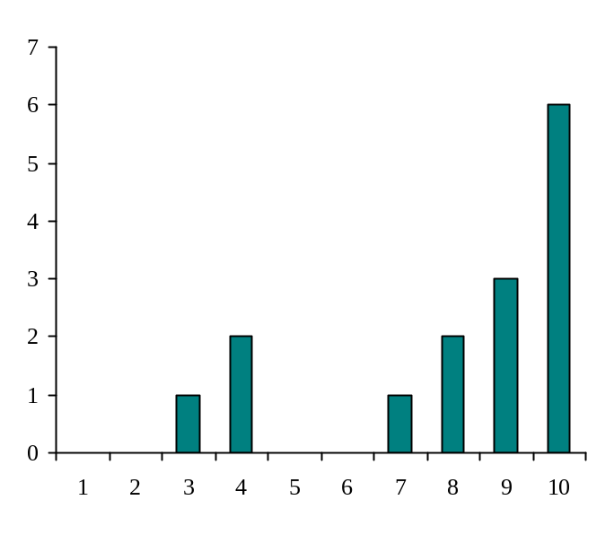
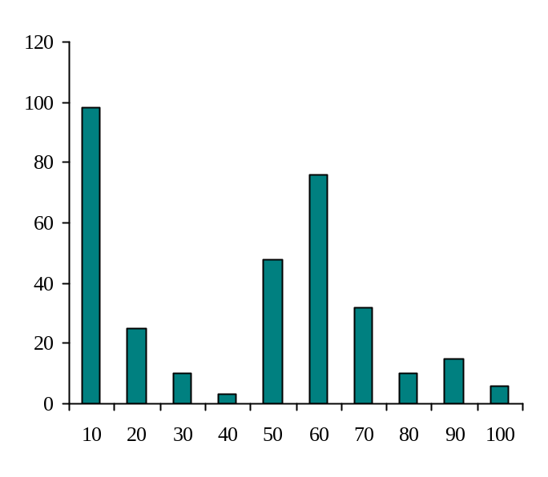
When To Use the Mode
The mode is not a very useful measure of central tendency
  It is insensitive to large changes in the data set
    That is, two data sets that are very different from each other can have the same mode

Slide 5
When To Use the Mode
The mode is primarily used with nominally scaled data
  It is the only measure of central tendency that is appropriate for nominally scaled data

Slide 6
The Median
The median is simply another name for the 50th percentile
  It is the score in the middle; half of the scores are larger than the median and half of the scores are smaller than the median

Slide 7
How To Calculate the Median
Conceptually, it is easy to calculate the median
  There are many minor problems that can occur; it is best to let a computer do it
Sort the data from highest to lowest
Find the score in the middle
  middle = (N + 1) / 2
  If N, the number of scores, is even the median is the average of the middle two scores

Slide 8
Median Example
What is the median of the following scores:
10 8 14 15 7 3 3 8 12 10 9
Sort the scores:
15 14 12 10 10 9 8 8 7 3 3
Determine the middle score:
middle = (N + 1) / 2 = (11 + 1) / 2 = 6
Middle score = median = 9

Slide 9
Median Example
What is the median of the following scores:
24 18 19 42 16 12
Sort the scores:
42 24 19 18 16 12
Determine the middle score:
middle = (N + 1) / 2 = (6 + 1) / 2 = 3.5
Median = average of 3rd and 4th scores:
(19 + 18) / 2 = 18.5

Slide 10
When To Use the Median
The median is often used when the distribution of scores is either positively or negatively skewed
  The few really large scores (positively skewed) or really small scores (negatively skewed) will not overly influence the median

Slide 11
The Mean
The mean is:
  the arithmetic average of all the scores
  (ΣX)/N
  the number, m, that makes Σ(X - m) equal to 0
  the number, m, that makes Σ(X - m)² a minimum
The mean of a population is represented by the Greek letter μ; the mean of a sample is represented by X

Slide 12
Calculating the Mean
Calculate the mean of the following data:
1 5 4 3 2
Sum the scores (ΣX):
1 + 5 + 4 + 3 + 2 = 15
Divide the sum (ΣX = 15) by the number of scores (N = 5):
15 / 5 = 3
Mean = X = 3

Slide 13
When To Use the Mean
You should use the mean when
  the data are interval or ratio scaled
    Many people will use the mean with ordinally scaled data too
  and the data are not skewed
The mean is preferred because it is sensitive to every score
  If you change one score in the data set, the mean will change

Slide 14
Measures of Dispersion
There are three main measures of dispersion:
  The range
  The semi-interquartile range (SIR)
  Variance / standard deviation

Slide 15
The Range
The range is defined as the difference between the largest score in the set of data and the smallest score in the set of data, X_{L} - X_{S}
What is the range of the following data:
4 8 1 6 6 2 9 3 6 9
The largest score (X_{L}) is 9; the smallest score (X_{S}) is 1; the range is X_{L} - X_{S} = 9 - 1 = 8

Slide 16
When To Use the Range
The range is used when
  you have ordinal data or
  you are presenting your results to people with little or no knowledge of statistics
The range is rarely used in scientific work as it is fairly insensitive
  It depends on only two scores in the set of data, X_{L} and X_{S}
  Two very different sets of data can have the same range:
  1 1 1 1 9 vs 1 3 5 7 9

Slide 17
The Semi-Interquartile Range
The semi-interquartile range (or SIR) is defined as the difference of the first and third quartiles divided by two
  The first quartile is the 25th percentile
  The third quartile is the 75th percentile
SIR = (Q₃ - Q₁) / 2

Slide 18
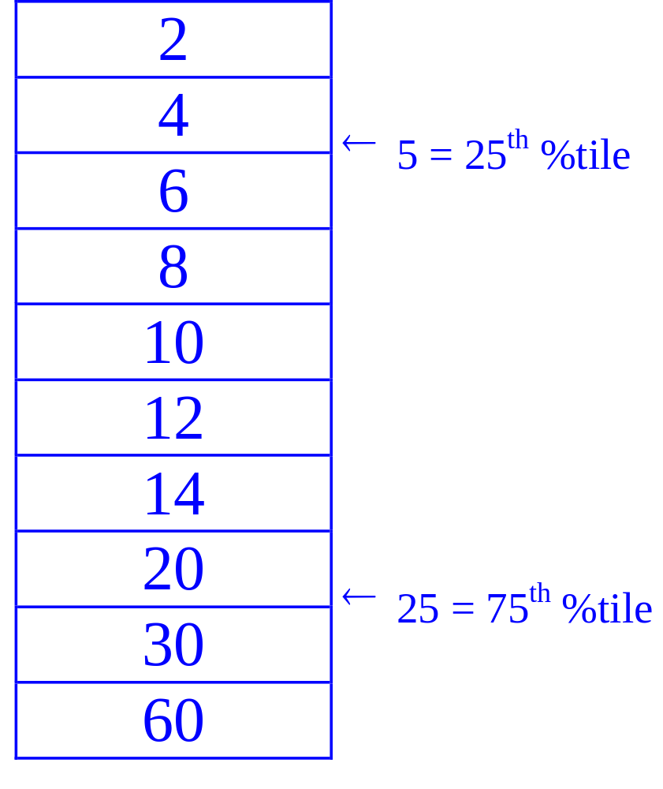
SIR Example
What is the SIR for the data to the right?
25 % of the scores are below 5
  5 is the first quartile
25 % of the scores are above 25
  25 is the third quartile
SIR = (Q₃ - Q₁) / 2 = (25 - 5) / 2 = 10

Slide 19
When To Use the SIR
The SIR is often used with skewed data as it is insensitive to the extreme scores

Slide 20
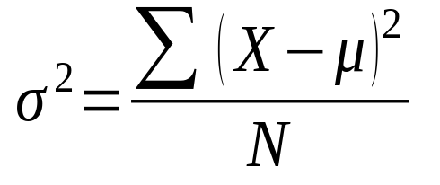
Variance
Variance is defined as the average of the square deviations:

Slide 21
Standard Deviation
When the deviate scores are squared in variance, their unit of measure is squared as well
  E.g. If people’s weights are measured in pounds, then the variance of the weights would be expressed in pounds² (or squared pounds)
Since squared units of measure are often awkward to deal with, the square root of variance is often used instead
  The standard deviation is the square root of variance

Slide 22
Standard Deviation
Standard deviation = √variance
Variance = standard deviation²

Slide 23
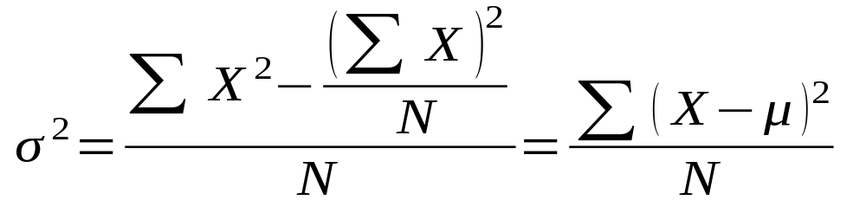
Computational Formula
When calculating variance, it is often easier to use a computational formula which is algebraically equivalent to the definitional formula:
σ² is the population variance, X is a score, μ is the population mean, and N is the number of scores

Slide 24
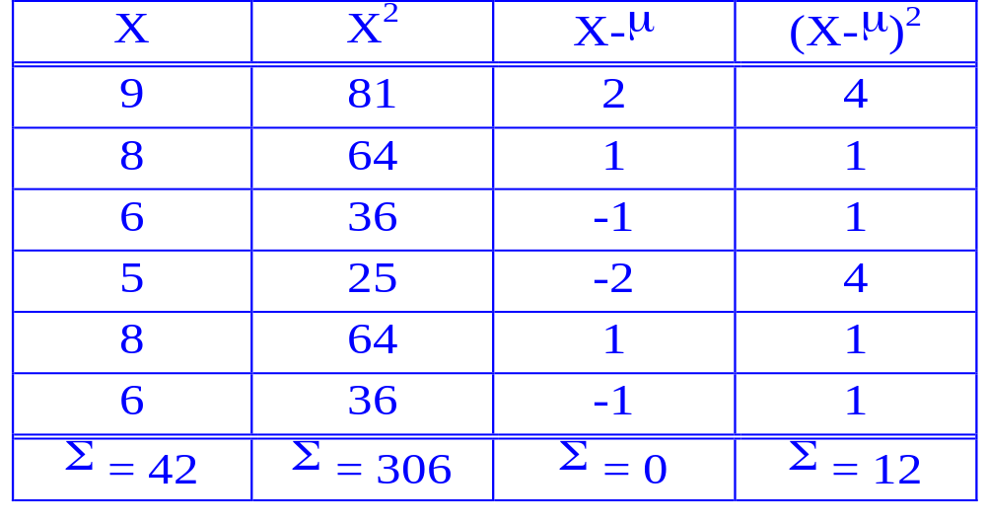
Computational Formula Example

Slide 25
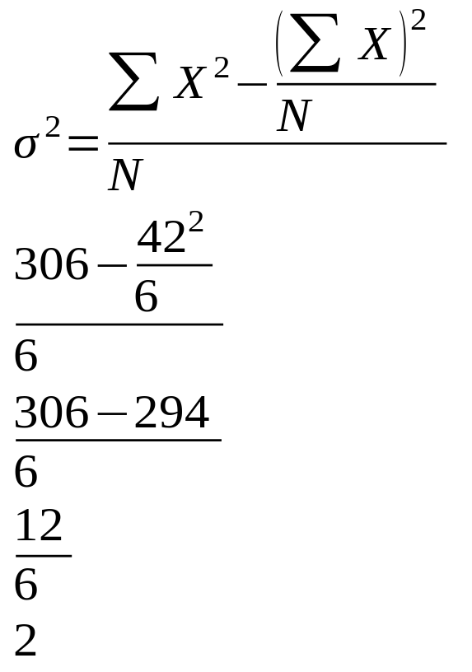
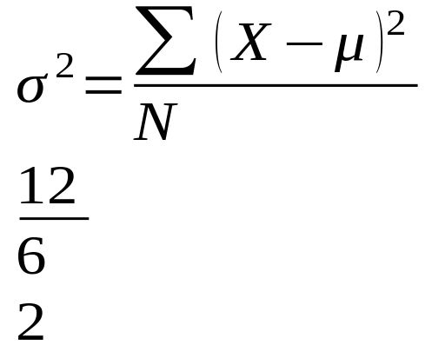
Computational Formula Example

Slide 26
Central Limit theorem
The central limit theorem states that whenever a random sample of size n is taken from any distribution with mean and variance, then the sample mean will be approximately normally distributed with mean and variance. The larger the value of the sample size, the better the approximation to the normal.

Slide 27
Assumptions of Central Limit Theorem
1. The sample should be drawn randomly following the condition of randomization.
2. The samples drawn should be independent of each other. They should not influence the other samples.
3. When the sampling is done without replacement, the sample size shouldn’t exceed 10% of the total population.
4. The sample size should be sufficiently large.

Slide 28
Central Limit Theorem
Conclusions:
1. The distribution of sample x will, as the sample size increases, approach a normal distribution.
2. The mean of the sample means will be the population mean µ.
3. The standard deviation of the sample means will approach σ/ .
n

Slide 29
Central Limit Theorem for Sample Means
Simulate distributions of sample means from various types of populations.
Calculate the mean and standard error of a sampling distribution given the parameters of the population.
Describe how the shape of a distribution of sample means approaches normality as sample size increases.
Calculate the Z‐score of a sample mean using the mean and standard error from a sampling distribution.

Slide 30
Thank YOU !!!

